Slide 1
India After the Guptas
Gupta Dynasty collapsed in 535 from Hun invasions
Believers of Buddhism split.
Theravada- “teachings of the elders”
Way of life, not a religion,
Understanding oneself is the chief way to gain nirvana.
Mahayana- stressed that nirvana could be achieved through devotion to the Buddha.
Believed Theravada too strict,
Buddhism is a religion, not a philosophy,
Buddha divine
Nirvana a true heaven
Both declined in India but gained followers in China, Japan, Korea, and SE Asia

Slide 2
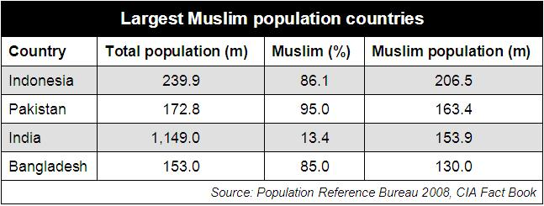
Expansion of Islam in India
In Northwest India.
Division of the subcontinent into mostly Hindu India and two Islamic states, Bangladesh and Pakistan.

Slide 3
Expansion of Islam
What was Islam successful? Islam arrived when there was a lot of division in India.
India had been divided into 70 states (and they fought each other constantly!)
10th century Islamic expansion.
New Islamic state known as Ghazni (in Afghanistan) is founded.
By 1200, Muslim power had reached over the entire plain of northern India.
A new Muslim state known as the Sultanate of Delhi was formed.

Slide 4
Timur Lenk
Military force crossed the Indus River and raided the capital of Delhi.
100,000 Hindu prisoners were massacred
Timur Lenk (Tamerlane)
Mongol ruler in Samarkand (old Chagatai Khanate).
1380s placed the entire region east of the Caspian Sea under his authority and then occupied Mesopotamia.
Died in 1405

Slide 5
Islam and Indian Society
Strict separation b/w Muslim ruling class and Hindu population.
Many Muslim rulers were intolerant of other faiths.
Peaceful means to convert people to Islam, but some destroyed Hindu temples.
Notes:
Too many Hindus to convert.

Slide 6
Economy and Daily Life
Peasant farmers
Landed elites and merchants lived in cities.
Farming and trade were important.

Slide 7
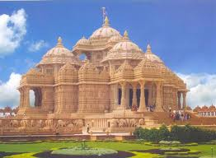
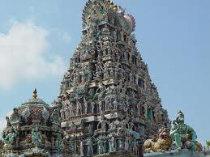
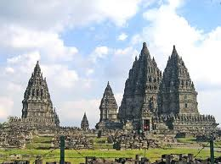
Indian Culture
Temples (Hindu)

Slide 8
Indian Culture
Sanskrit Prose
6-7th centuries.
Dandin
The Ten Princes
Created a fantastic world.

